Slide 1

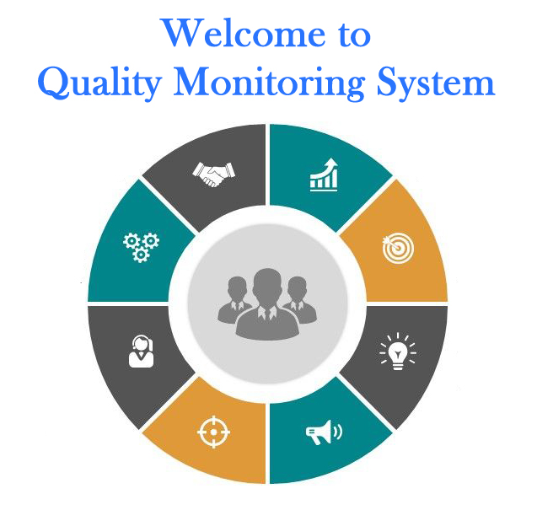
Quality Monitoring Framework for Government ITIs running under Public-Private Partnership (PPP)
Summer Internship Programme
in association with
Department of Technical Education, Training and Skill Development
Government of West Bengal
Group Members –
1) Subh Priyadarshi - BITS Pilani (Hyderabad campus)
2) Saransh Srivastava - BITS Pilani (Pilani campus)
3) Jay Sharma - BITS Pilani ( Pilani campus)
Skill Set Requirements: Web Development (through PHP version 8 – MySQL)

Slide 2
Mentors
Mr. Bappaditya Haldar, DIT
Mr. Siddhartha Bose, Addl. DIT as Nodal Officer
Mr. Ramesh Venkatraman as BITS Faculty Mentor
Project Guidance
Mr. Arnab Acharyya, ITI Specialist, SPIU
Mr. Arindam Acharyya, Principal, Govt. ITI, Haldia
Mr. Nilanjan Kundu, ADIT

Slide 3
SPECIAL ACKNOWLEDGEMENTS
Mr. Saibal Sengupta, JDIT
Mr. Narayan Chandra Mandal, DDIT
Mr. Angsujit Das, DDIT
Mr. Sanjib Mondal, DDIT
Mr. Prasenjit Bose, ADIT

Slide 4
INTRODUCTION
DGT: DGT is the apex organisation in Ministry of Skill Development and Entrepreneurship for development and coordination at National level for the programmes relating to vocational training.
NCVT: The National Council for Vocational Training, an advisory body, was set up by the Government of India in 1956 .
DIT: DIT imparts craftsmen & training to a substantial number of youth in different trades for supply of skilled manpower to different industries.
ITI: Industrial Training Institutes, also known as ITIs have been established with an aim to provide industrial training to students.
PPP Mode: A public–private partnership is a cooperative arrangement between two or more public and private sectors, typically of a long-term nature.

Slide 5
BACKGROUND STUDY
After going through details we thought that following parameters may be monitored centrally for better training:
Attendance Monitoring.
Curriculum Progress Monitoring.
Quality monitoring through weekly/monthly Assessment.
Student rating & review of a teacher based on communication, teaching, and discipline.
Teacher’s approval of adequate material and technical support from ITI’s.
Average earnings of graduates in their profession compared to the nationwide average for the particular trade
Student feedback

Slide 6
Problem Definition
The objective of this project is to develop an IT/software-based solution to the problem of creating an effective framework for monitoring the quality of Government Industrial Training Institutes (ITIs) operating under the Public-Private Partnership mode.
The software solution can be delivered through a Desktop Application, Web Application or Mobile Application.
However, Web Applications are most widely used, and the Web is the most ubiquitous platform across all electronic devices, so it has been decided to develop a Web application, so the monitoring system is most widely and conveniently accessible to anyone who requires it.

Slide 7

SOFTWARE DEVELOPMENT LIFE CYCLE
The process of software development, summarized in a few brief steps

Slide 8
PHASES OF SOFTWARE DEVELOPMENT LIFE CYCLE
Problem Definition
Feasibility Study
Requirement Analysis & Specification
Designing
Front End – HTML, CSS, JS, PHP
Database – Tables to store data (using ER diagram)
Functional – defining users and their requirements, access level, and other functions
Coding (PHP version 8-MySQL) – to implement Designing phase
Testing
Documentation
Notes:
Only steps here

Slide 9

FEASIBILITY STUDY OF THE MODULEs

Slide 10
What is a feasibility study?
Feasibility is the measure of how beneficial or practical the development of an informati
system will be to an organization
Types of feasibility
Technical: This assessment focuses on the technical resources available to the organization and whether the technical team is capable of converting the ideas into working systems.
Economic: This assessment typically involves a cost/ benefits analysis of the project, helping organizations determine the viability, cost, and benefits associated with a project before financial resources are allocated
Time: A time feasibility study will take into account the period in which the project is going to take up to its completion. A project will fail if it takes too long to be completed before it is useful.

Slide 11
ATTENDANCE MONITORING
INITIAL PROPOSALS
Can be done for trainees
It can also be done for Instructors.
Frequency of monitoring can be daily, weekly or monthly.
Monitoring will be done Trade-wise and subject-wise (TT, TP, WCS, ED, ES)
Changes AFTER Feasibility Study
Due to time feasibility only trainees taken under condition.
Frequency of monitoring is done monthly due to time constraint.
Notes:
Distribute content of this slide across multiple slides, 2 modules per slide (including halted student feedback module)
All users in one slide

Slide 12
CURRICULUM PROGRESS MONITORING
INITIAL PROPOSALS
Monitoring done for an ITI Trade.
It can also be done for Instructors.
Frequency of monitoring can be daily, weekly or monthly.
Monitoring will be done Trade-wise and subject-wise (TT, TP, WCS, ED, ES)
Changes AFTER Feasibility Study
Frequency of monitoring – weekly (four entries a month) due to time feasibility.
Notes:
Distribute content of this slide across multiple slides, 2 modules per slide (including halted student feedback module)
All users in one slide

Slide 13
QUALITY MONITORING THROUGH ASSESSMENT
INITIAL PROPOSALS
Evaluation done through uploaded marks.
Monthly assessment will be conducted by ITIs for their trainees
Frequency of monitoring – component-wise, monthly (once a month) as per monthly assessment
Monitoring will be done Trade-wise and subject-wise (TT, TP, WCS, ED, ES)
AFTER
Frequency of monitoring – monthly (once a month) as per monthly assessment
Notes:
Distribute content of this slide across multiple slides, 2 modules per slide (including halted student feedback module)
All users in one slide

Slide 14
TEACHING AIDS MONITORING
INITIAL PROPOSALS
Monitoring will be done for various modern teaching aids
Data will be updated through YES/NO entries indicating availability of each teaching aid
Frequency of monitoring –monthly, half-yearly & annually.
Monitoring will be done ITI wise, since most classrooms use similar teaching aids
Changes AFTER Feasibility Study
Frequency of monitoring – monthly (once a month).
To maintain the uniformity of the report submission, the frequency is set to monthly submission.
Notes:
Distribute content of this slide across multiple slides, 2 modules per slide (including halted student feedback module)
All users in one slide

Slide 15
PLACEMENT MONITORING
INITIAL PROPOSALS
Data from the last 3 years to be monitored for
Average percentage of placement among graduates
Average salary among graduates
Frequency of monitoring – monthly, half-yarly & annually (once a year).
Monitoring will be done Trade-wise and subject-wise (TT, TP, WCS, ED, ES)
Changes AFTER Feasibility Study
All the module requirements are feasible.
To maintain the uniformity of the report submission, the frequency is set to monthly submission.
Notes:
Distribute content of this slide across multiple slides, 2 modules per slide (including halted student feedback module)
All users in one slide
To maintain the uniformity of the report submission, the frequency is set to monthly submission.

Slide 16
STUDENT FEEDBACK
INITIAL PROPOSALS
As the name suggests, feedback will be taken from students about the instructors and institutes
Frequency of monitoring – monthly (once a month)
Monitoring will be done ITI wise, with individual data input from each student
This module is currently placed on halt due to time constraints
Changes AFTER Feasibility Study
Feedback requires a new user namely student.
Requires a new interface.
Ruled out due to time feasibility.
Notes:
Distribute content of this slide across multiple slides, 2 modules per slide (including halted student feedback module)
All users in one slide

Slide 17
Feasibility Study
Out of several parameters for monitoring that were originally considered, five were determined to be objective enough to design data gathering modules for: Attendance Monitoring, Curriculum Progress Monitoring, Quality Monitoring via Assessment, Teaching/Learning Aids Monitoring, and Placement Monitoring.
A student feedback module was considered but is currently placed on halt due to time constraints. It may be implemented time permitting, but it is not being slated for development right now.
Finally for all the modules the frequency of monitoring is decided as monthly (once a month).
Notes:
Only steps here

Slide 18

REQUIREMENT ANALYSIS & SPECIFICATION
1. Data Requirements
2. Functional Requirements
3. Entity-Relationship Diagram
4. Data Control Flow

Slide 19

DATA REQUIREMENTS
What data input is required by each module

Slide 20
Attendance Monitoring
Institute's NCVT MIS code
Year of admission
Trade
Month for which attendance data is being updated
Year for which attendance data is being updated
Trainee's name
Total hours delivered for Trade Theory
Number of hours attended in Trade Theory
Total hours delivered for Trade Practical
Hours attended in Trade Practical
Total hours delivered for Workshop Calculation and Science
Hours attended in Workshop Calculation and Science
Total hours delivered for Engineering Drawing
Hours attended in Engineering Drawing
Total hours delivered for Employability Skills
Hours attended in Employability Skills

Slide 21
CURRICULUM Progress Monitoring
Institute's NCVT MIS code
Year of admission
Trade
Month for which attendance data is being updated
Week for which attendance data is being updated
Year for which attendance data is being updated
Progress made in Trade Theory
Progress made in Trade Practical
Progress made in Workshop Calculation and Science
Progress made in Engineering Drawing
Progress made in Employability Skills

Slide 22
QUALITY Monitoring THROUGH ASSESSMENT
Marks obtained in Trade Theory
Total marks in Trade Theory
Marks obtained in Trade Practical
Total marks in Trade Practical
Marks obtained in Workshop Calculation and Science
Total marks in Workshop Calculation and Science
Marks obtained in Engineering Drawing
Total marks in Engineering Drawing
Marks obtained in Employability Skills
Total marks in Employability Skills
Institute's NCVT MIS code
Year of admission
Trade
Month for which attendance data is being updated
Year for which attendance data is being updated
Trainee's name

Slide 23
Teaching Aids MONITORING
Institute's NCVT MIS code
Calendar year for which data is being entered
Calendar month for which data is being entered
Availability of PROJECTOR(Y/N)
Availability of DIGITAL WHITEBOARD(Y/N)
Availability of AUDIO_SYSTEM_WITH_MICROPHONE(Y/N)
Availability of E-LEARNING / E-CONTENTS (Y/N)

Slide 24
Placement Monitoring
Institute's NCVT MIS code
Trade
Current placement year
Placement % for the current year
Average salary for the current year
Placement % for the previous year
Average salary for the previous year
Placement % for the 2nd previous year
Average salary for the 2nd previous year

Slide 25
ENTITY RELATIONSHIP DIAGRAM

Slide 26
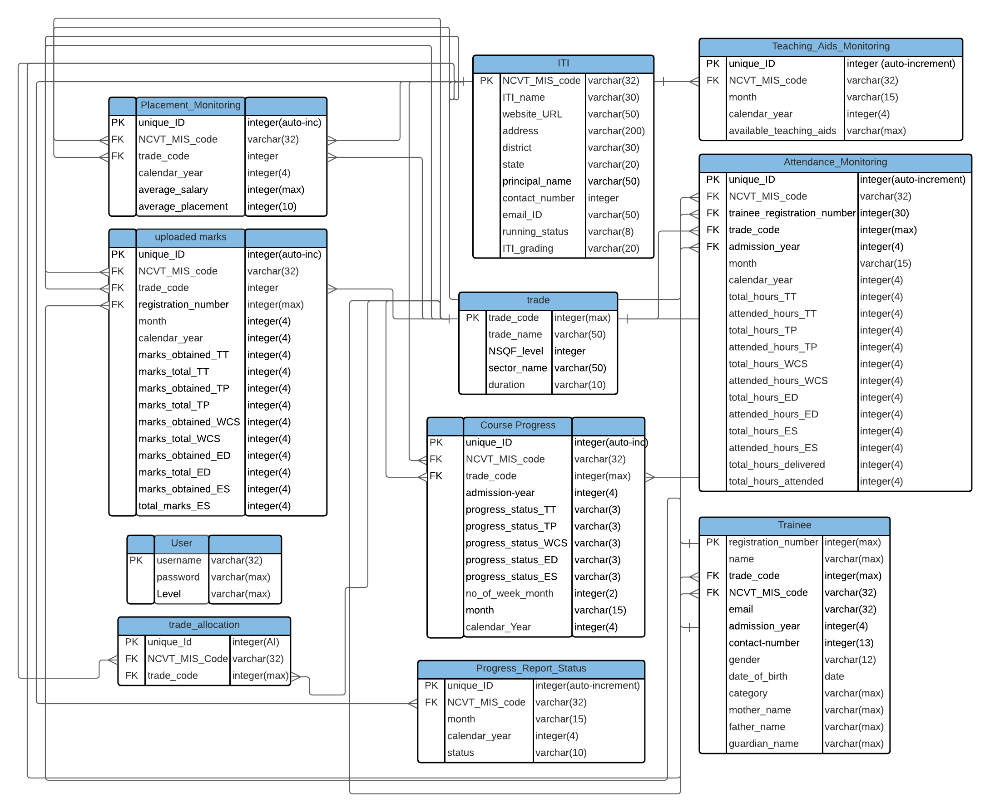

Slide 27

DATA CONTROL FLOW
The pathway data takes through the system

Slide 28
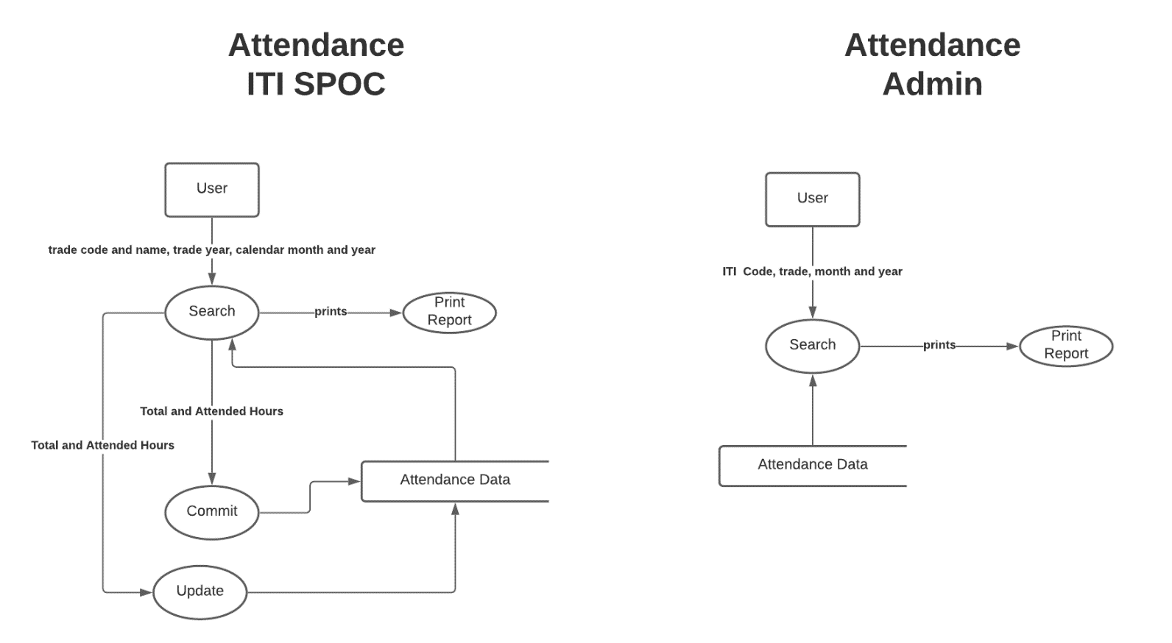
ATTENDANCE MONITORING

Slide 29
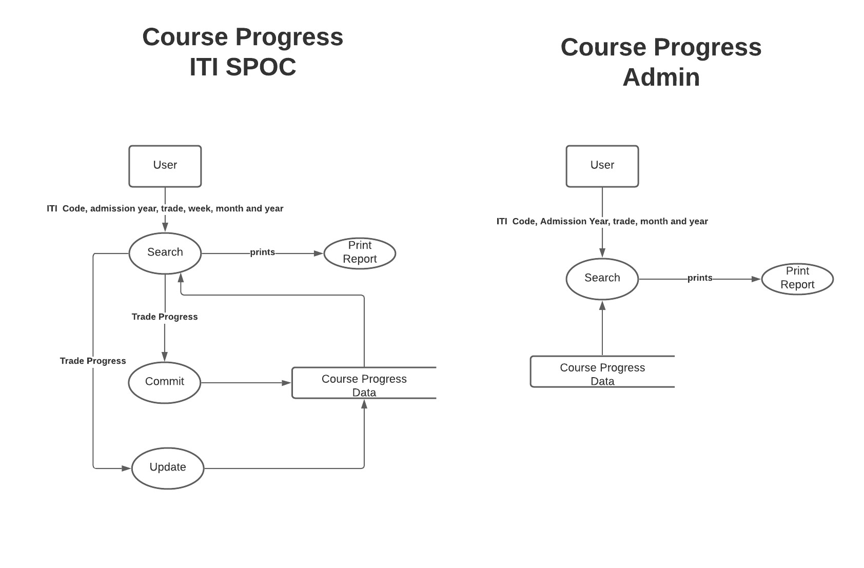
CURRICULUM PROGRESS MONITORING

Slide 30
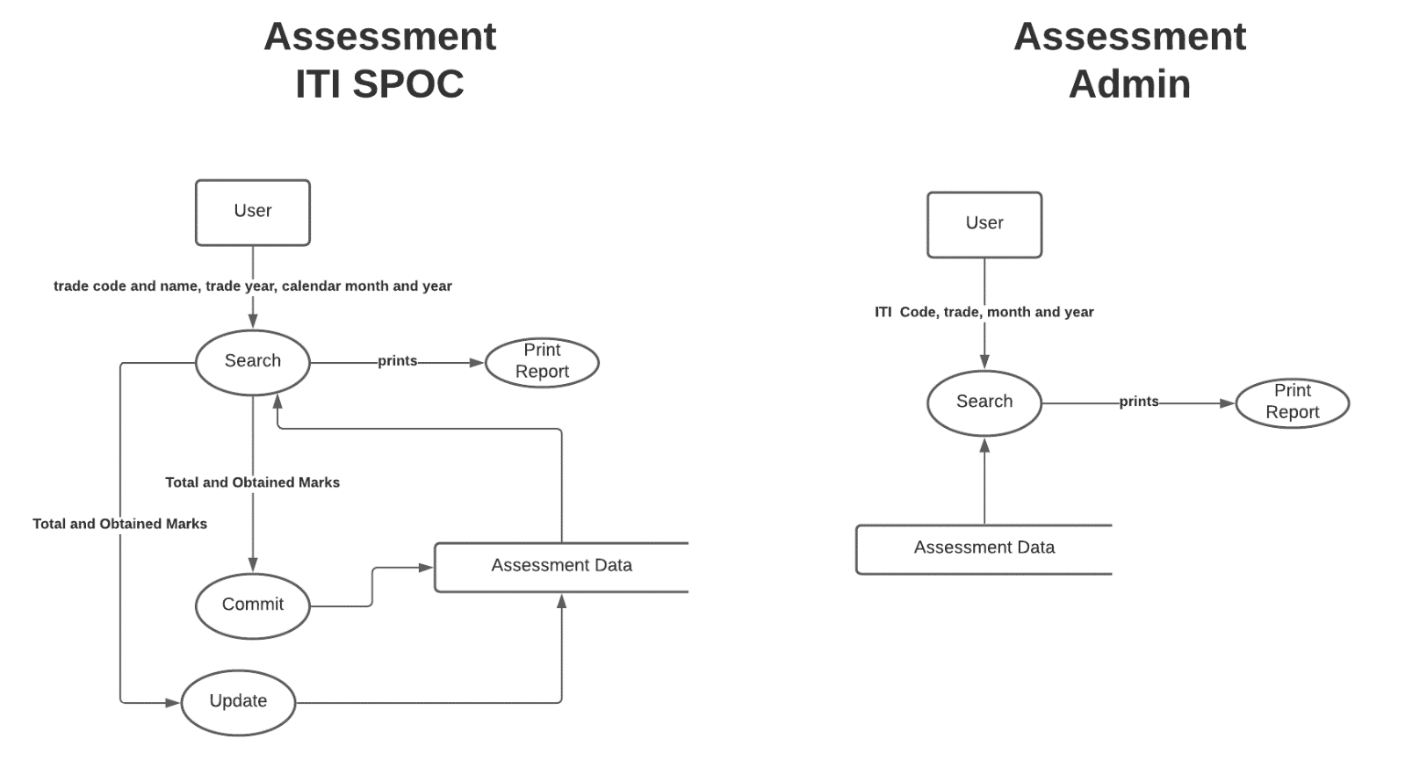
QUALITY MONITORING THROUGH ASSESSMENT

Slide 31
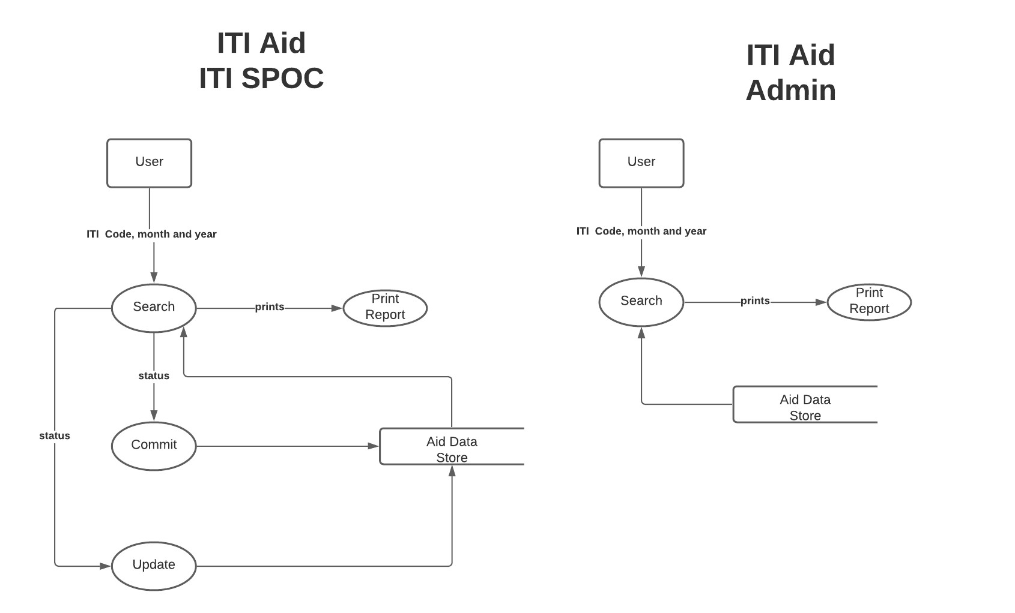
TEACHING AID MONITORING

Slide 32
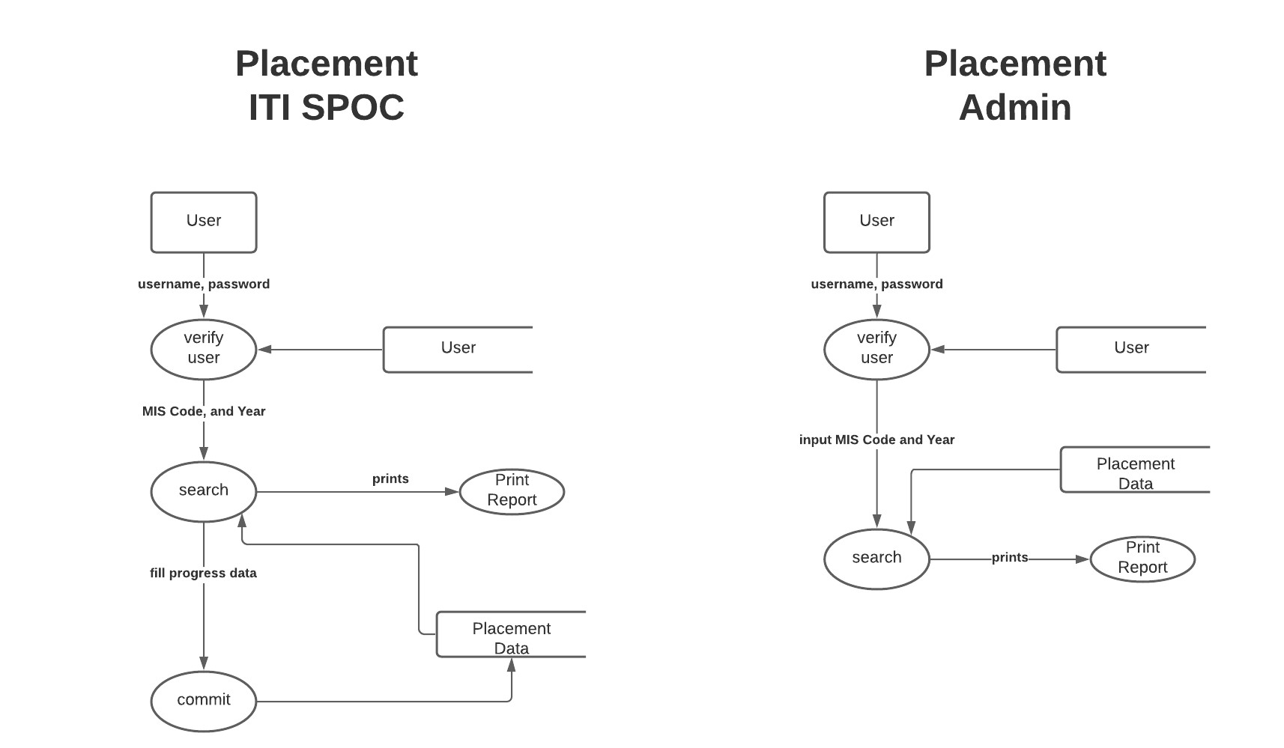
PLACEMENT MONITORING

Slide 33

WEB VIEWS
What the graphical interface for each module will look like when opened on the web
Website-link
http://localhost/php/index.html
Notes:
Insert the links for the localhosts login website.

Slide 34
FUTURE PLANS
Coding – writing program code for the web application to implement all the modules.
Testing

Slide 35
THANK YOU

